Slide 1

Team ViralTech
Jialei Chen, Carl Porter, Colton Spector, Weiheng Su

Slide 2
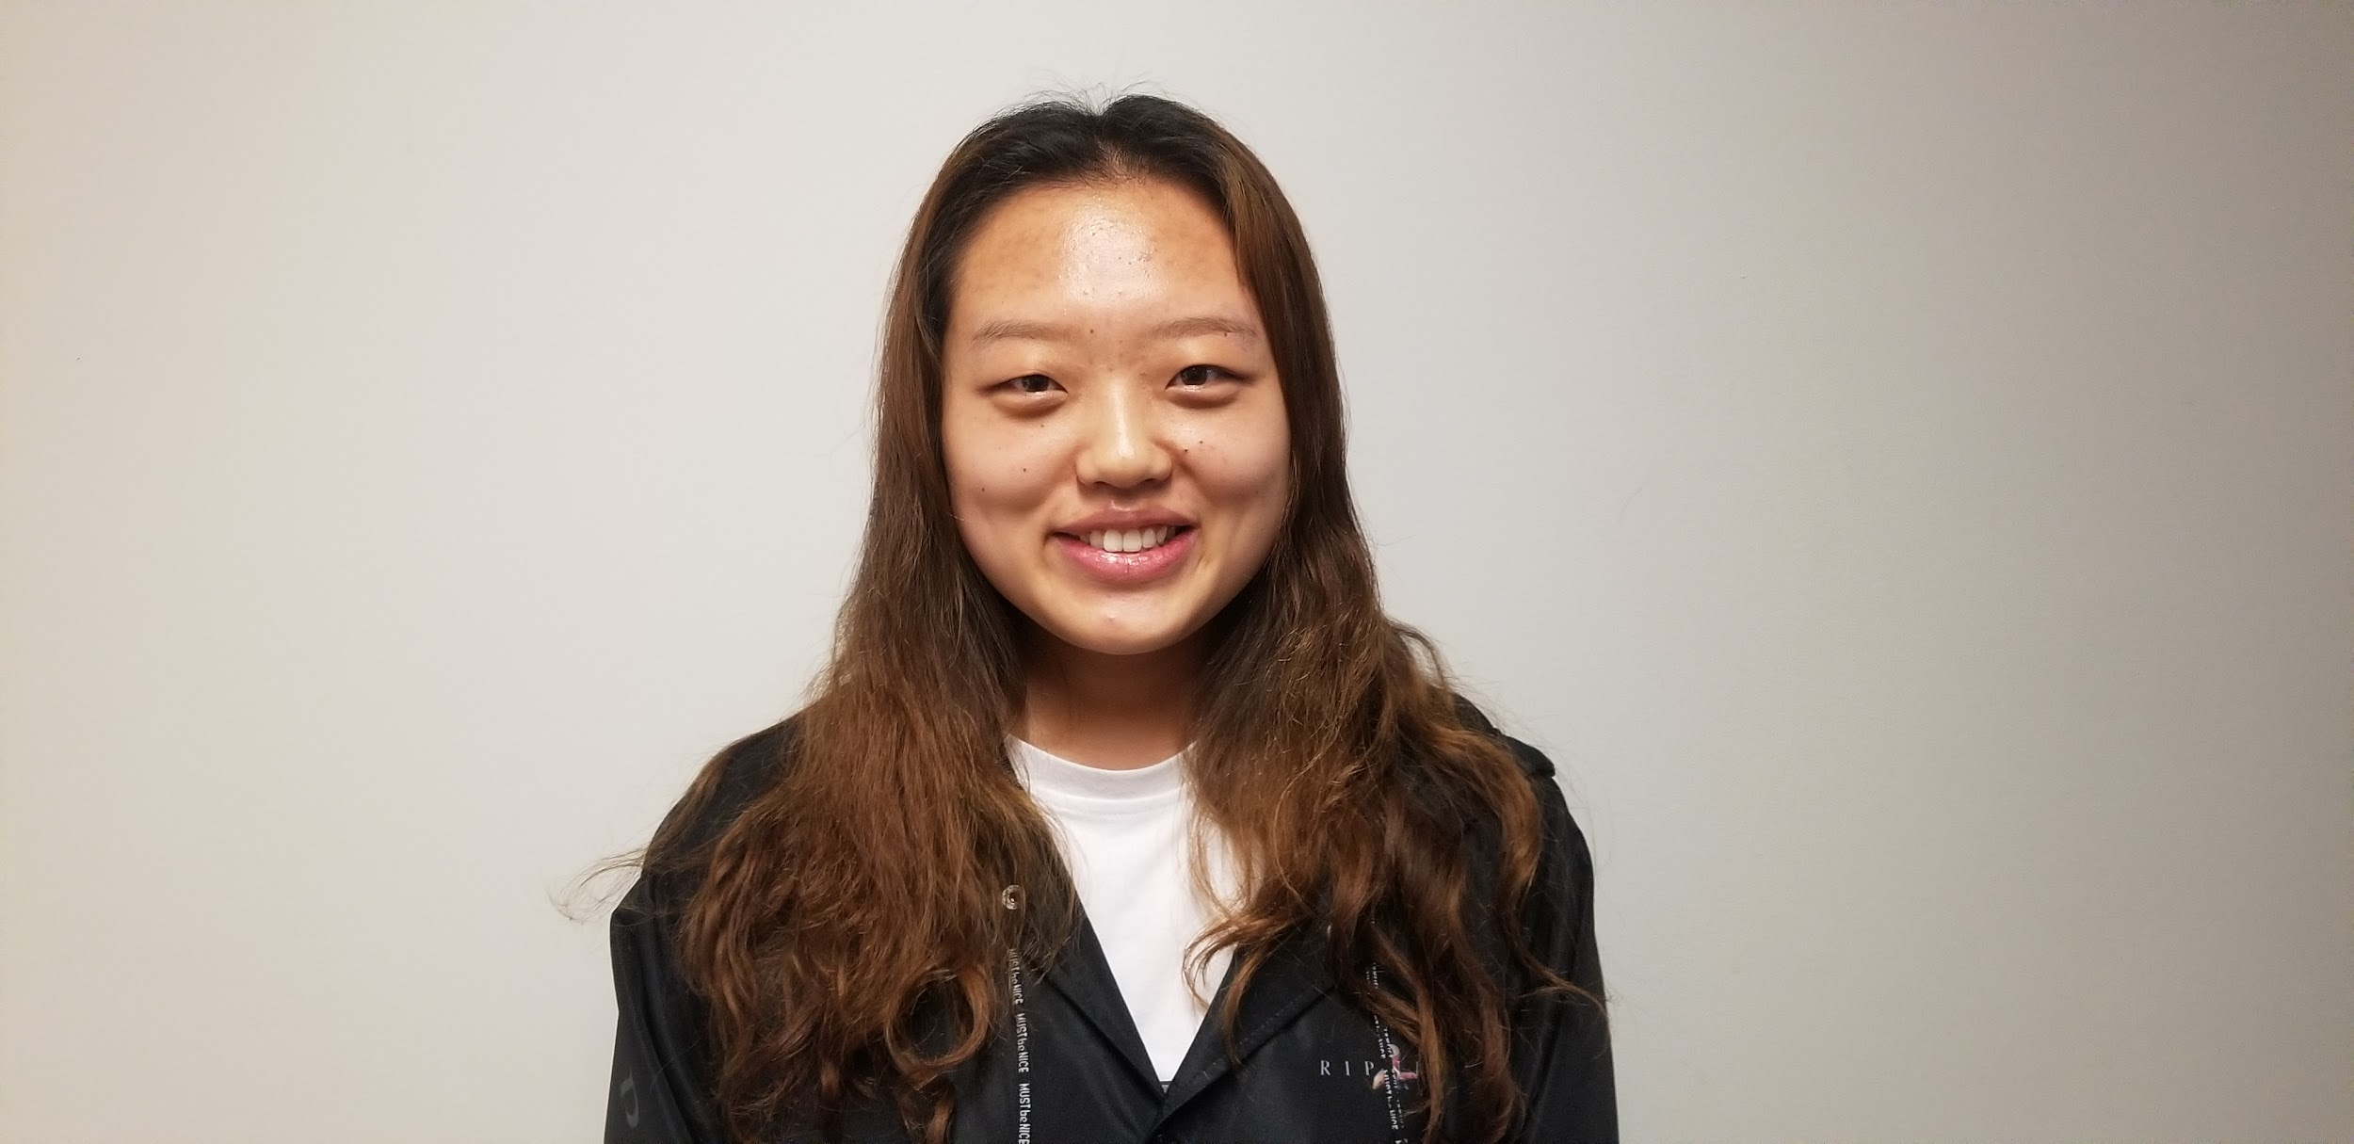
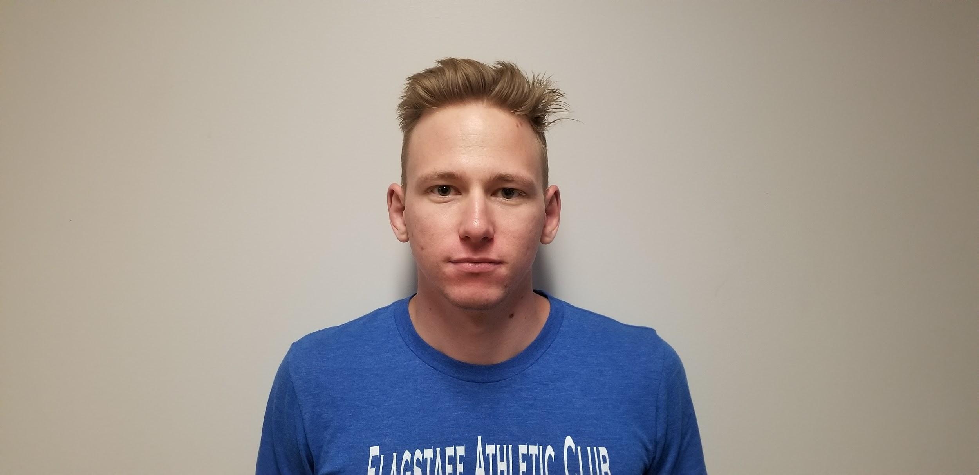
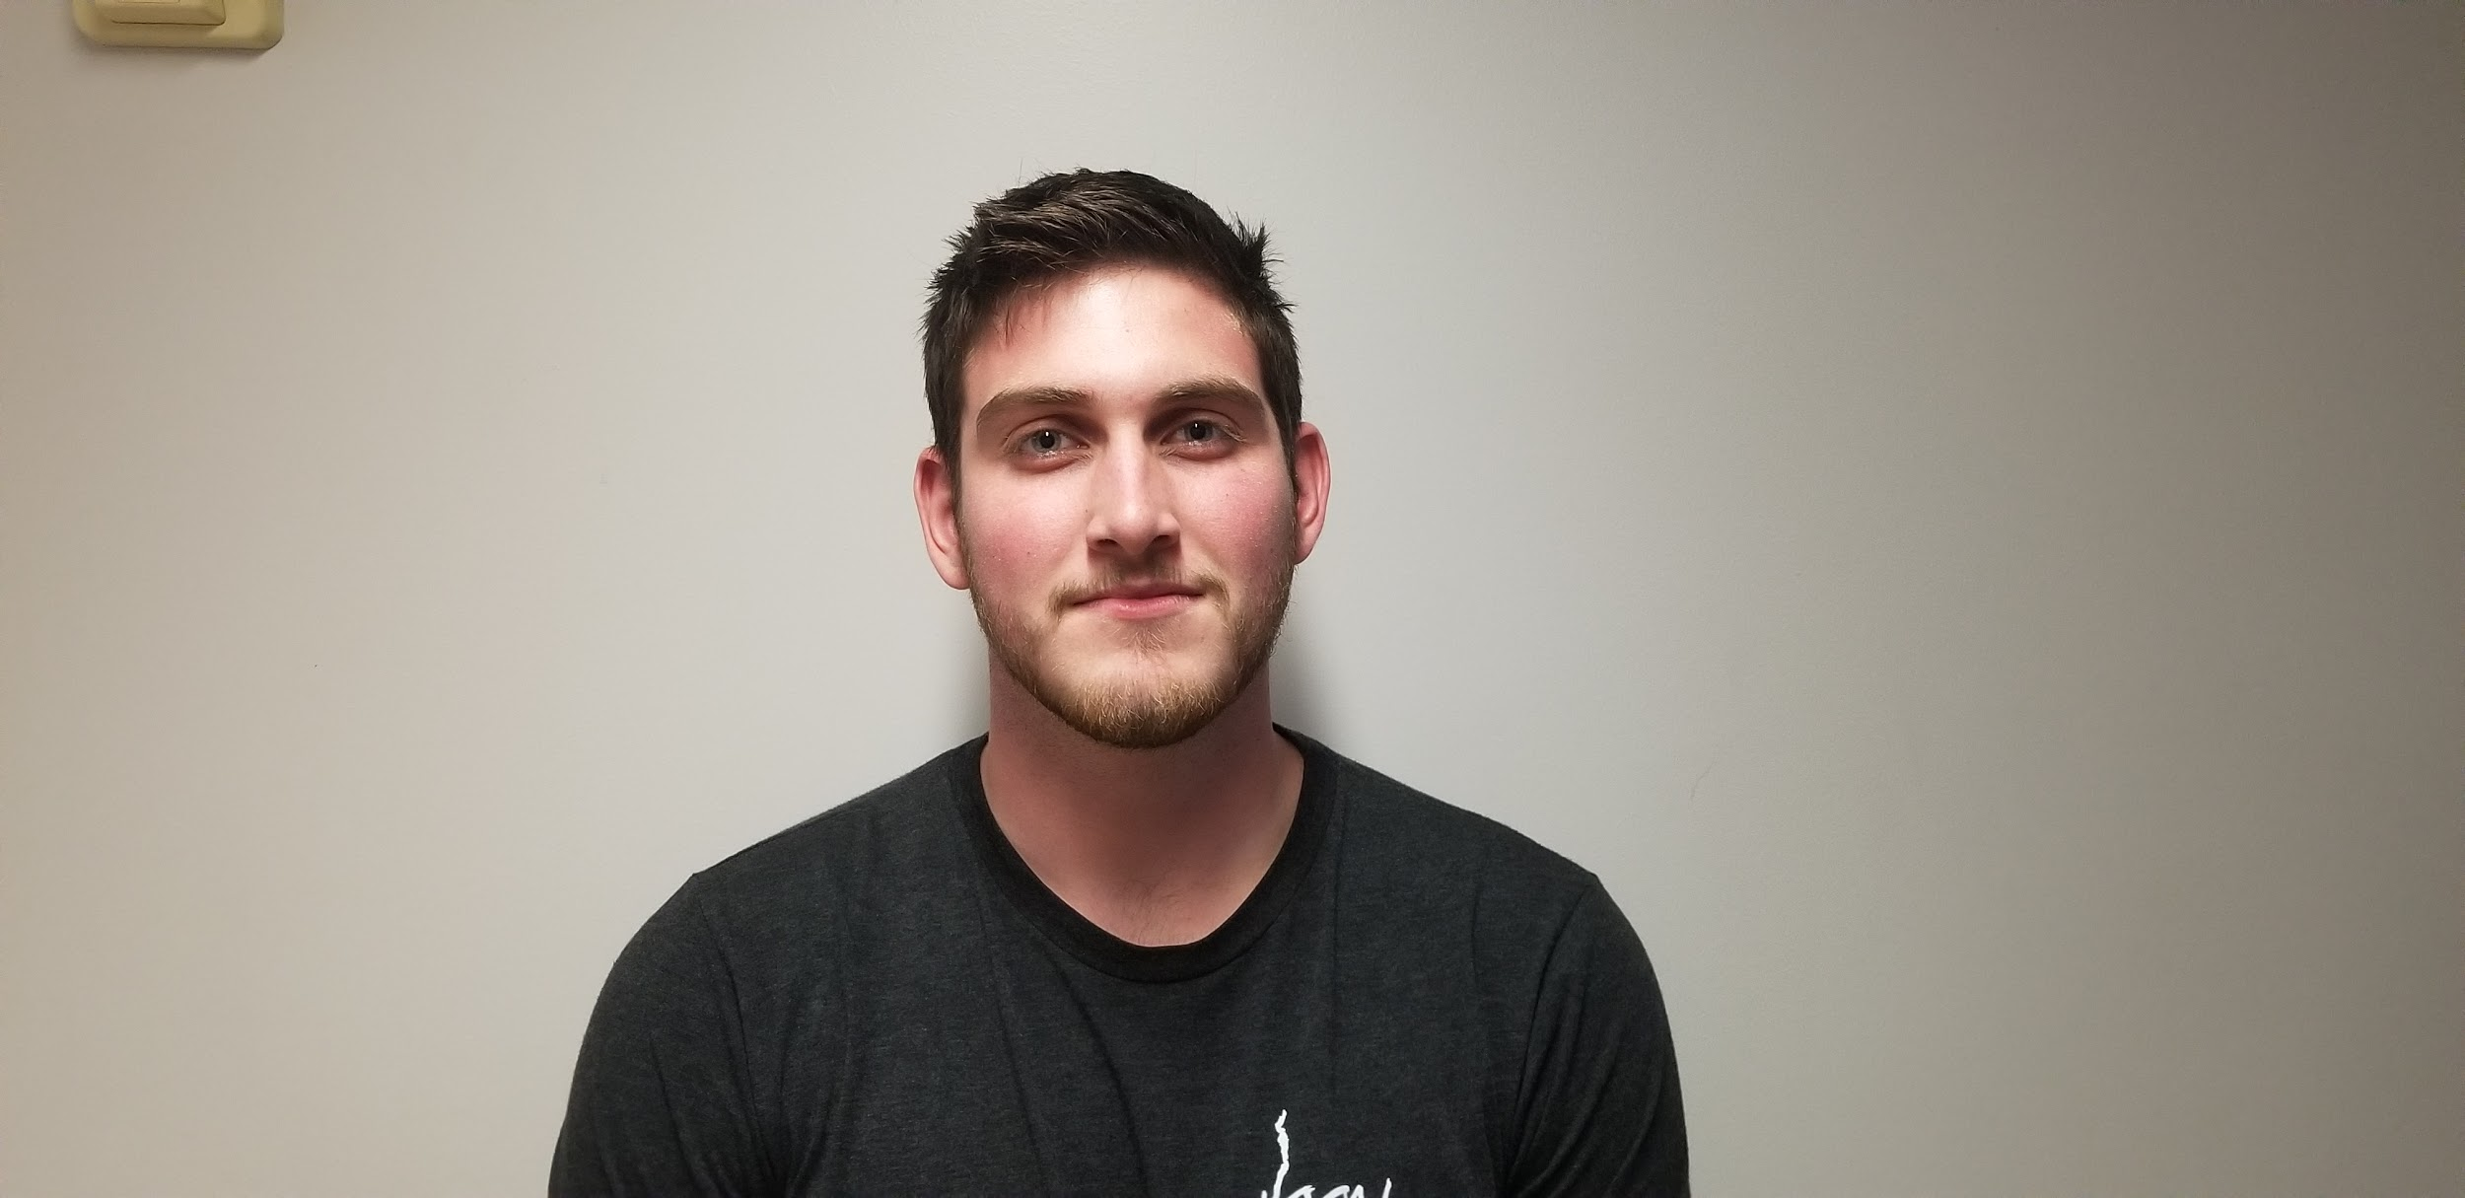
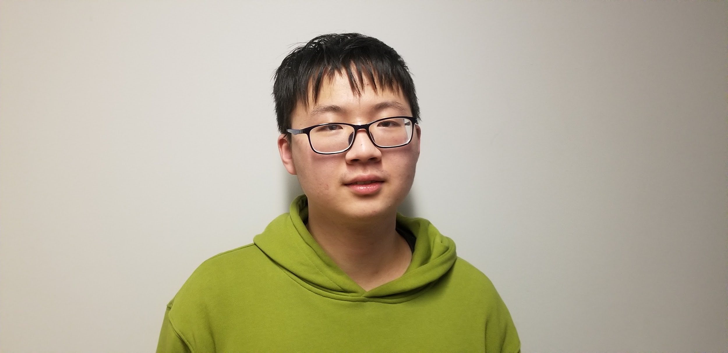
Team Members
Jialei Chen Carl Porter Colton Spector Weiheng Su
（Team Lead）

Slide 3
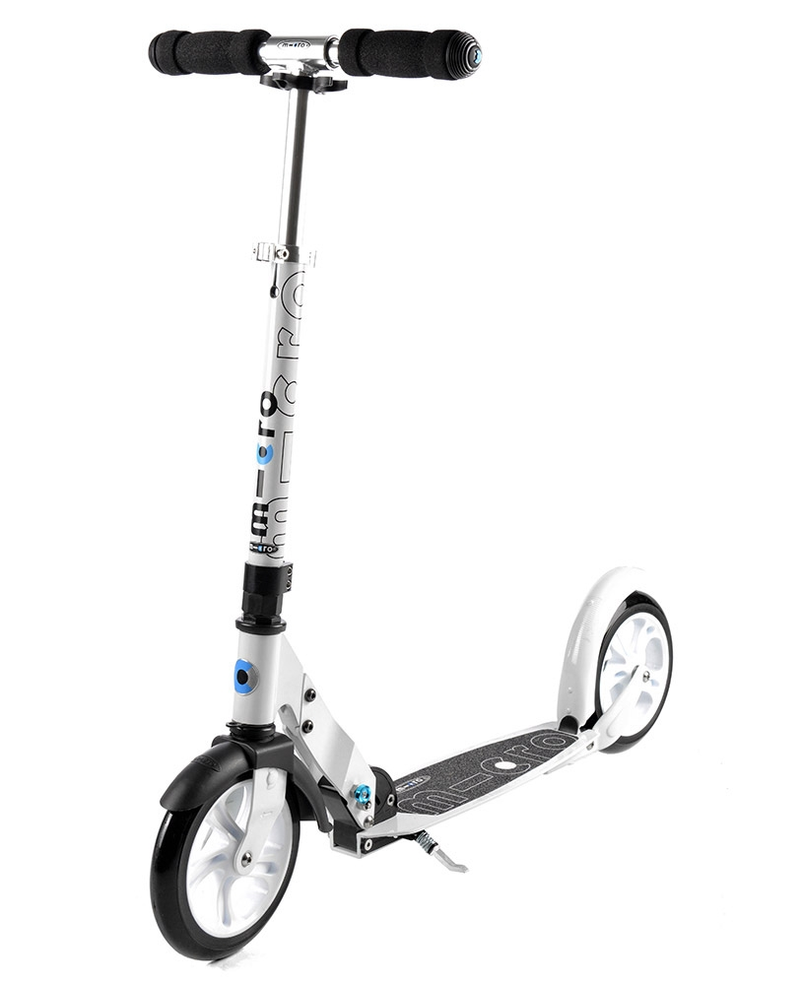
Project Name & Our Faculty Mentor
Project Name: PIMpoint Collaborator Data Entry Point
Faculty Mentor:
Notes:
First 3 slides = 15 seconds max

Slide 4
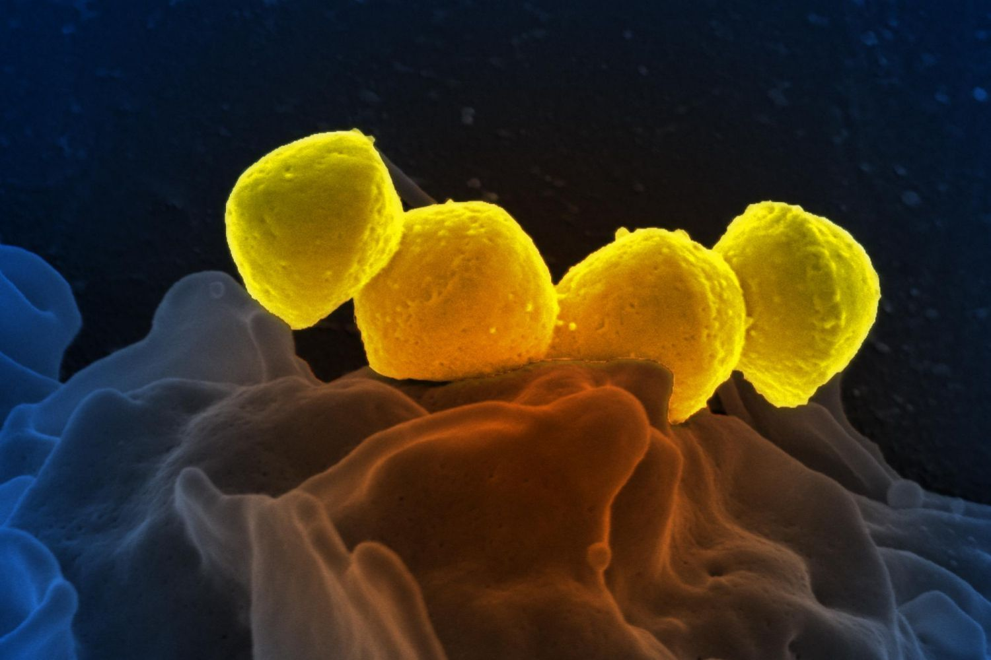
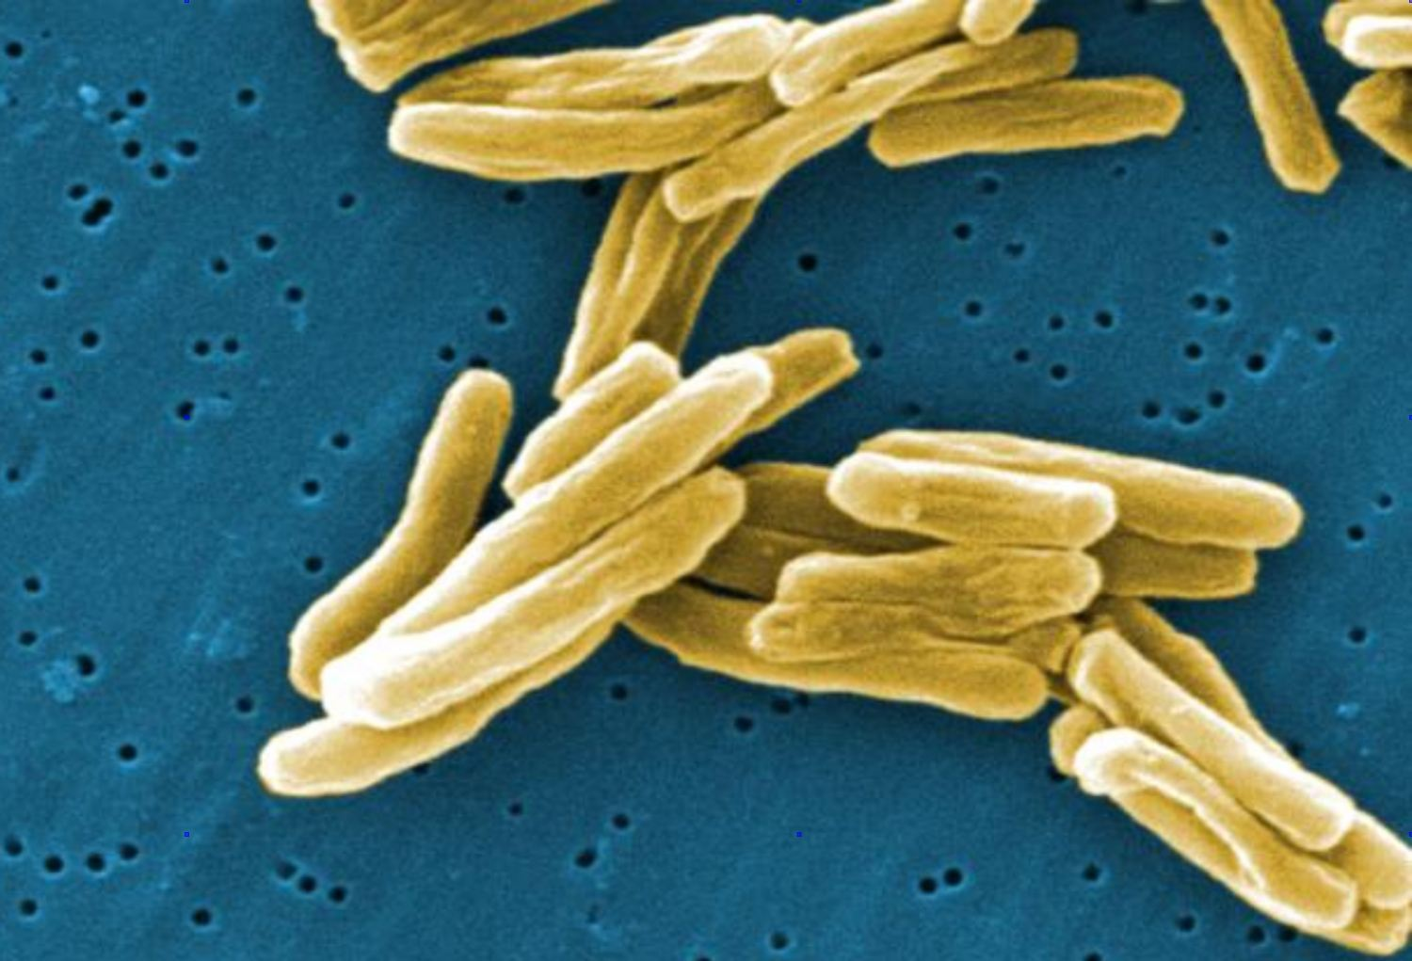
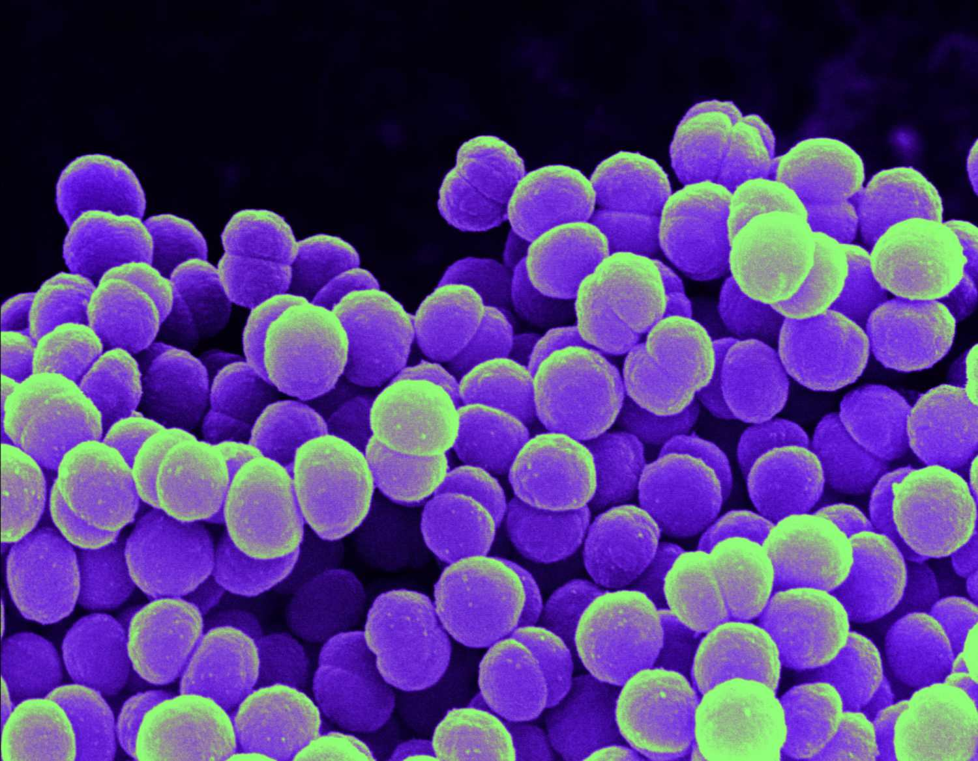
Intro
Notes:
Necrotizing Fasciitis (Flesh-eating Disease)
Tuberculosis
Meningitis
The fight against viruses and pathogens is one that will last until we cease to exist. From the bubonic plague to the ebola virus, us humans are under constant threat of one of these strains mutating and having the opportunity to wipe out a good portion of our population

Slide 5
About TGen North
Research at TGen North
Pathogen Genomics Division – Focused on bacterial and fungal pathogens associated with medicine, public health, and biodefense
Outbreak detection and source tracing
Developing clinical diagnostic tests
Characterizing antibiotic resistance
Notes:
SUPER COOL RESEARCH ABOUT ANTIBIOTIC RESISTANT TUBERCULOSIS
Intro: To quote an incredibly intelligent man's paper(Doerrys paper), Scientific research is driven by data, and research into pathogens and viruses is incredibly important work. TGen North

Slide 6
Global Cooperation And Challenge
There is a high demand for new solutions, treatments and cures requiring the dedication of countless scientists, researchers, and specialists from all over the world.
Cooperation at this global scale is no small task; errors can lead to significant increases in the time it takes to get results.

Slide 7
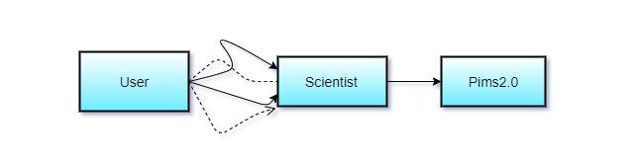
Current Workflow
Notes:
The current workflow is unstandardized and messy in its current state.

Slide 8
Problems With Current Workflow
Manual data entry done by scientists
Non-standardized data collection
Data associated with samples is dynamic, often changing on a case by case basis

Slide 9
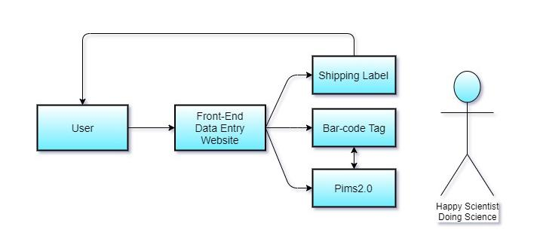

Solution
Notes:
At this early stage of our understanding, we envision solving solving the problem by creating a Website for TGEN & their contributors, that also communicates with their current database. In this app, users could log in securely, then do be able to enter in all the required data about ". Again, follow that overall intro through with your concrete example. If you do this right, it will be obvious to the whole room that your solution very clearly does brilliantly solve the problem/deficiency you just described.
Pim-point is a set of web based interfaces that allow users to interact with the Pim-point database in a variety of different ways. Data Entry, Data Querying,Tracking the location of samples, Moving samples, Labeling samples, ect.

Slide 10

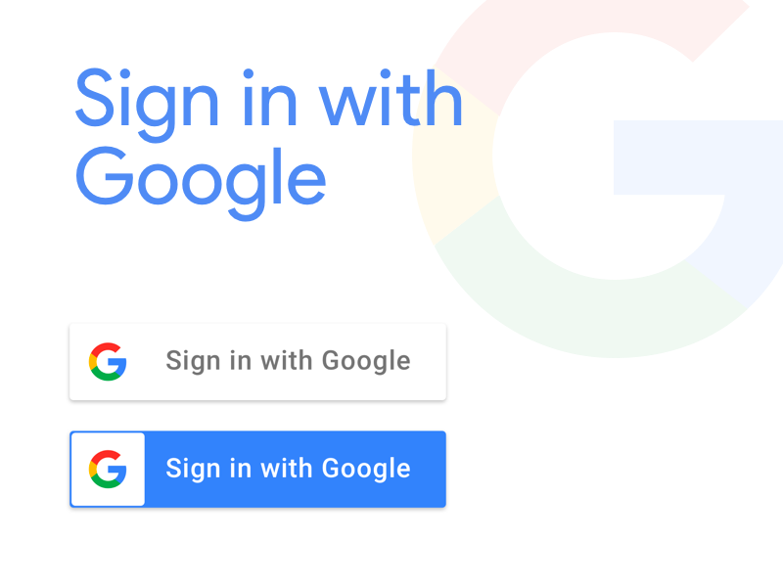
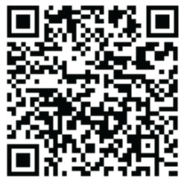
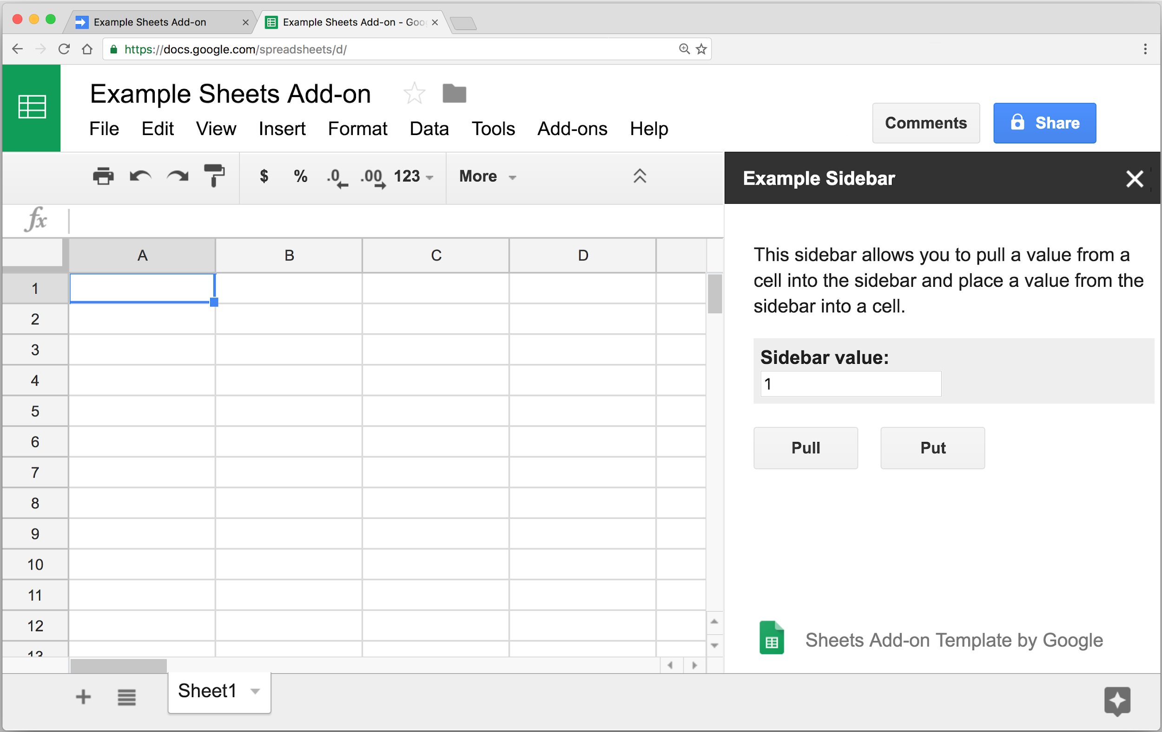
Future Development Plans
Gather Requirements
Bi-weekly meetings with client to iteratively refine:
Back-end data flowchart
Front-end design mockups
Feature list
Technologies to Investigate
Notes:
Json Tuples are involved
New spreadsheet service other than Google
Google Authentication?
Barcode Creator

Slide 11
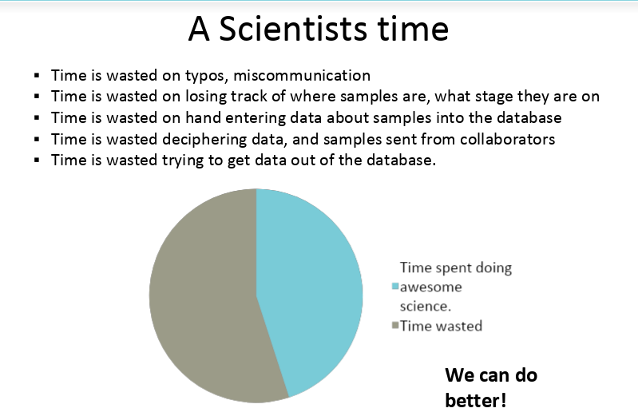
Notes:
In summary, we are Team ViralTech, and we are working to create a well rounded web-based data entry point for our client, that both assists collaborators and the scientists by removing the need for additional data entry from the hands of collaborator to the hands of the scientists.
Jonathan Todd who is an assistance BioInformatician has had some real challenges in the area of Web Design & Development but we are confident that we on track to provide them with a very effective solution.
Whereas before it took their scientists about 60% of their time inputting data, and most collaborators QR codes are misplaced on the samples or are not included. We hope to cut down the Scientists need to input data about the sample by 20% and be able to ensure 90% of all incoming samples are tagged correctly so when it gets to the hands of the scientists all they have to do is scan the barcode and begin their work.

Slide 12
Thanks for watching
Notes:
In summary, we are Team ViralTech, and we are working to create a well rounded web-based data entry point for our client, that both assists collaborators and the scientists by removing the need for additional data entry from collaborator to scientists.
Jonathan Todd who is an assistance BioInformatician has had some real challenges in the area of Web Design & Development but we are confident that we on track to provide them with a very effective solution.
Whereas before it took their scientists about 40% of their time inputting data, and most collaborators QR codes are misplaced on the samples or are not included. We hope to cut down the Scientists need to input data about the sample by 20% and be able to ensure 90% of all incoming samples are tagged correctly so when it gets to the hands of the scientists all they have to do is scan the barcode and begin their work.

